Slide 1
Finasteride Use for Trans Patients Undergoing Hair Restoration
Christine M. Shaver, M.D.

Slide 2
Disclosure of Relevant Financial Relationships
“I have no relevant financial relationships or conflicts of interest to declare”

Slide 3
Trans Patients – A Unique Group with Potential for Benefit from Finasteride
Most trans pts presenting are M → F, wanting feminine hairlines (focus of this talk)
Have male donor hair (back/sides) with good stability (DHT resistant)
Less risk for genetic thinning with chemical or physical castration
Hairline readily improved to feminine shape
Understand transformation is a process and amenable to two procedures for higher density
Insurance coverage (Amida Care – Medicaid)

Slide 4
Understanding the Medical Hx
Physical (removal of gonads) vs. Chemical castration
Complex hormonal meds: need to know
Estrogens (oral, sublingual, transdermal, intramuscular, subcutaneous)
Lower serum testosterone / raise estradiol
Gives secondary sex characteristics (breast growth, soft skin, dec muscle mass, female fat distrib.)
Can cause testicular/penile atrophy (erectile dysfunction/infertility); decreased libido
Estrogens can reverse male pattern baldness
Anti-androgens (spironolactone, flutamide, finasteride)
Blocks effects of testosterone (decreased erectile function)
Slows genetic thinning
GnRH agonists (Lupron)
Intramuscular every few months/$$$; blocks total testosterone
Progesterones
Activate androgen receptors slightly; can improve mood/libido
Breast growth via weight gain

Slide 5
Testosterone Goals
The normal female serum total testosterone is 15-70 ng/dL
Goal: 15-25 range. Pts need some T / do not want goal to be ‘zero’ T
If zero T: sluggish, sex drive plummets, mood low
Can be achieved w/castration or combos of hormonal meds
Finasteride increases circulating testosterones by 8-10%
Testosterone increases, but effect is prevented by blocking DHT (important for the scalp and hair loss)
Patients will say “I have zero testosterone” given castration/meds
Is it actually zero? Probably not.
Sources also exist from adrenals…still causes thinning especially in very genetically sensitive individuals to hair loss

Slide 6
How to Approach
Should we check testosterone levels? DHT levels?
Easier than that: focus on the clinical exam!
Consider finasteride if:
Presenting with thinning already
Strong family history of thinning
Thin, fine hair
Caution against finasteride if:
Any evidence of prior sexual dysfunction, depression, psych disturbances (esp. OCD, panic disorder, anxiety, depression, hypochondriasis)
Patient has hesitations about medicine
Consider minoxidil in all patients (w/ or w/o finasteride)
Gives some additional stability to existing hair
Lower systemic risks than F (main SE is local irritation)
Downside is facial hair growth

Slide 7
Downsides of Starting Finasteride
Risk of sexual dysfunction side effects, depression, cognitive changes and post finasteride syndrome
Note: Non-castrated trans women sometimes still use/want erectile function
Possible higher risk for decreased libido given lower overall starting T levels
Theoretical risk for breast lumps and potential cancer in patient on estrogens w/more breast tissue present

Slide 8
Benefits of Starting Finasteride
Decreased risk for future hair loss
Raises T slightly but blocks effects in DHT hormone-sensitive tissues
Side effects uncommon and reversible in most
Possible gynecomastia / increased breast growth
Decrease secondary hair growth; benefit for women

Slide 9
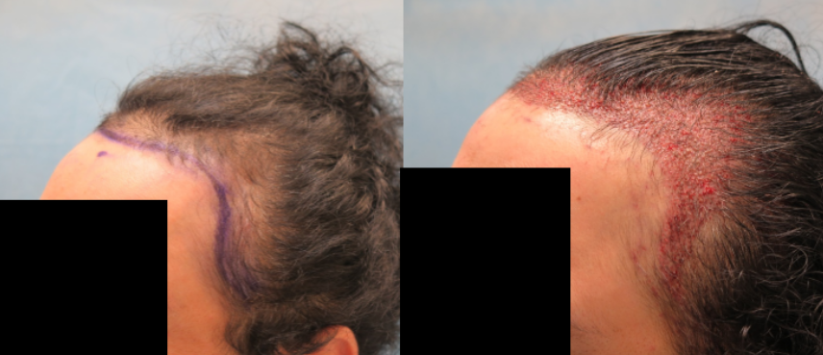
Benefits of Starting Finasteride
Less need for additional corrective hair transplants in the future
Can be aggressive with transplant and designing a feminine hairline
Female hairlines may only need 2 procedures
Temples, which require a significant number of grafts, can be transplanted
Can achieve the fullest possible look

Slide 10
Thank You!

